Slide 1



ENTO 8030: Advanced Quantitative Analysis in Entomological Science
Dr. Conor Fair
Fall 2026
MW 1:15 - 2:35
Course Introduction,
Types of Data, and Basics of R/RStudio

Slide 2
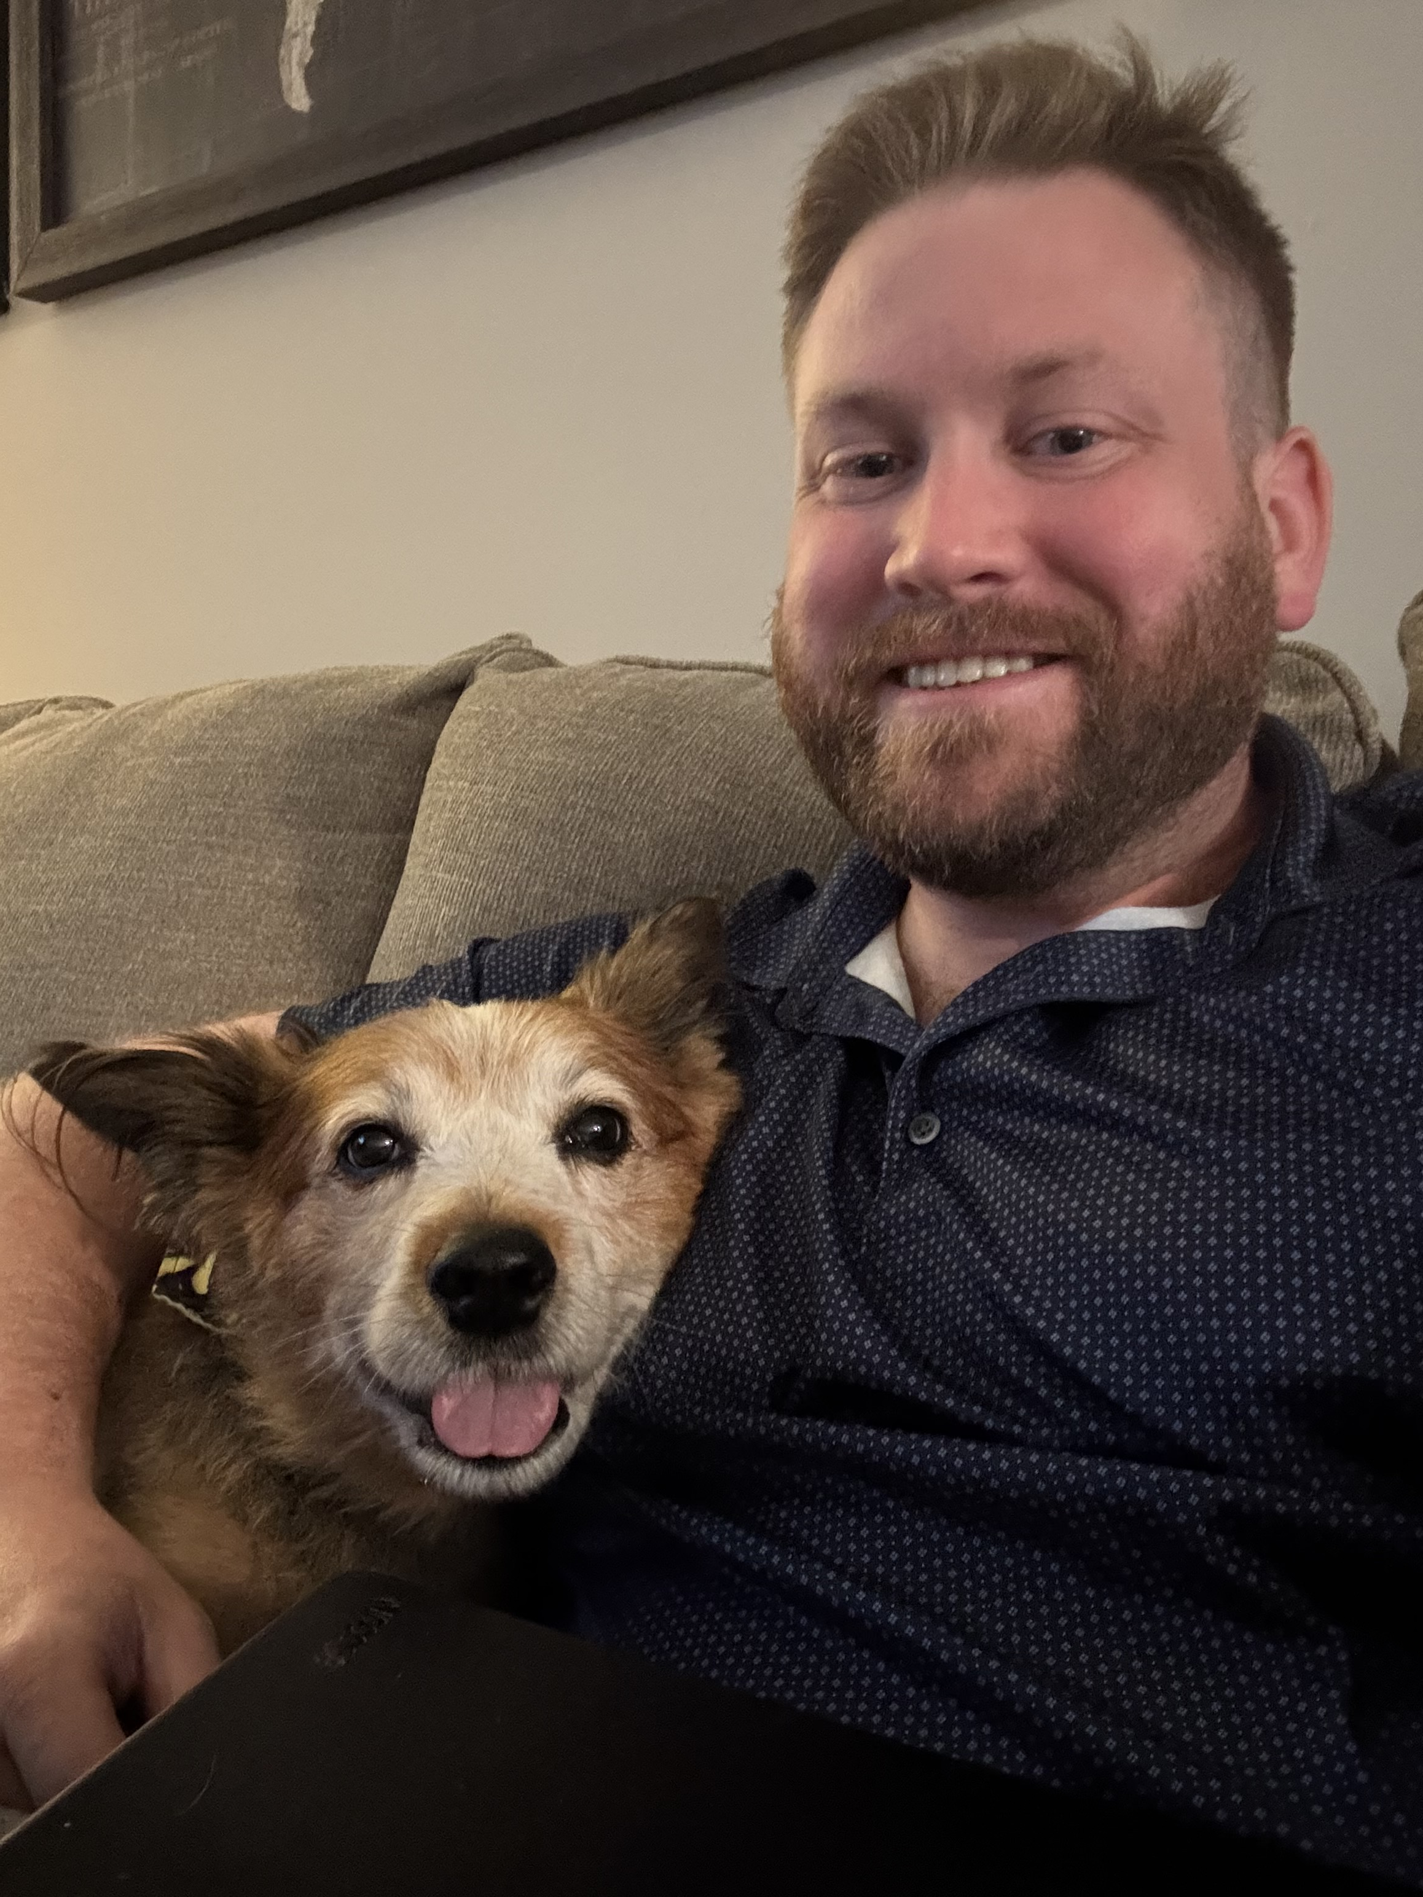

Introductions: Conor Fair
BA – Simpson College ’13
Biostatistics
MS – UGA Entomology ’15
FANR 6750 Exp. Methods in Forestry & Natural Resources
PhD. – UGA Entomology ’21
STAT 6220 Intro Stats II
FANR 7620 GIS Applications for Natural Resources
FISH 8360 Quantitative Conservation Sciences
POLS 8501 Advanced Quantitative Methods
STAT 8200 Experimental Design
POLS 8500 Time Series Analysis
PostDoc – UGA Entomology ‘22 & ‘23
Taught special topics course in statistics

Slide 3
General Syllabus Information
Method of instruction (virtual attendance across campuses)
Synchronous lectures M/W and discussion sections M/W/F
Communicating with the instructor (cfair13@uga.edu and elc)
Make-Up and late work
Flexible deadlines at the discretion of instructor
Resources for students (Disability Resources Center, Student Care & Outreach)
UGA’s Academic Honest Pledge
Statement on use of Generative AI tools

Slide 4
General Content in Stats Courses
Statistical theory
How to perform and recognize appropriate statistical tests
Using statistical software
Most variable task depending on software and difficulty
Research methods and experimental design
How to collect data and properly design experiments
Communicating statistics
Writing manuscripts and conference presentations

Slide 5
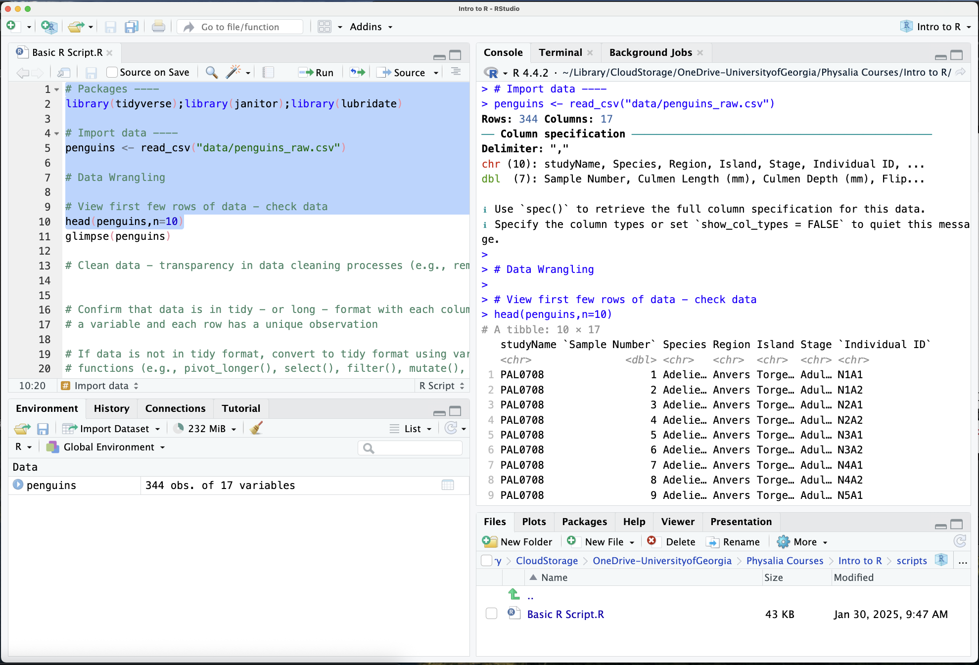
Learning Objectives
Functions, syntax, and file types in R/RStudio
Modify example code for your analyses
Statistical analyses with various data sets
Match analysis to experimental design
Publication quality data visualizations
Defend/Explain data analysis and results
Value and practice reproducible science

Slide 6
Structure of Course
Lectures (theory) cover statistics, experimental design, data management, etc.
Discussion (applied) sessions review practice problems and coding skills
Semester is broken into two sections
General R usage, basic statistics
Moderate statistics and Advanced topics chosen by students (see link on eLC)

Slide 7
Prerequisites
No specific prerequisites
Prior graduate-level course/experience recommended
FANR 6750: Experimental Methods in Forestry & Natural Resources Research
PBIO 8250: Experimental Design and Analysis in Field Plant Biology
CRSS 8010: Research Methods and Design for Crop Science
BIOS 7001: Foundations of Biostatistics
STAT 6210, 6220, 6310, 6315, 6320: Various stats courses for non-majors
Others???
Should have prior experience working with R/RStudio

Slide 8
Required Materials
Computer with R/RStudio software installed
No required textbook
Beckerman et al. 2017: Getting started with R: An Introduction for Biologists
Good introductory materials and examples
Free electronic copy through UGA library
Bolker 2008: Ecological Models and Data in R
More theoretical discussions of topics (good reference)
Hadley et al. 2017: R for Data Science
Free online

Slide 9
Course Assignments
Package Report
Learn how to use help files
AI-Assisted Statistical Analysis
Importance of drafting clear and detailed prompts
Student Presentations
Practice presenting your data analysis
Exams – two with cumulative material covered

Slide 10
Participation and Grades
“Ungrading” policy where you grade your progress toward developing your skills
Participation and attendance are encouraged
I know you have other responsibilities
Communicate when you’ll be absent
Grading Scale
A 93-100 points
A- 90-92 points
B+ 87-89 points
B 83-86 points
B- 80-82 points
C+ 77-79 points
C 73-76 points
C- 70-72 points
D 60-69 points
F Fewer than 60 points

Slide 11
Why Have You Taken This Class?
Think to yourself
Pair with your neighbor for a discussion
Share with the class

Slide 12
Advanced Topics Selection
What topics have you heard of?
What topics might come up in your own research?
What topics do you want to learn about?
Meta-Analysis
Generalized Additive Models
Bayesian Statistics
Multi-Variate Analysis (NMDS, etc.)
Time-Series Analysis
Structural Equation (Latent Variable) Models

Slide 13
Types of Data
How would you categorize/describe different types of data?

Slide 14
Types of Data
Dependent vs. Independent variable
Response vs. Manipulated variable
Y vs. X variable
What are some examples?
Continuous
Integer
Ordinal
Proportional
Categorical (Nominal)
Presence/Absence)

Slide 15
Types of Data
Dependent vs. Independent variable
Response vs. Manipulated variable
Y vs. X variable
What are some examples?
Nominal: treatment groups
Integer: counts
High complexity
Low complexity
Ordinal: high, medium, low
Continuous: decimals (e.g., temp.)

Slide 16
Types of Data
How does the type of data relate to your hypothesis?
… your analysis?
… your interpretation/visualization of your data?
Nominal: treatment groups
Integer: counts
High complexity
Low complexity
Ordinal: high, medium, low
Continuous: decimals (e.g., temp.)

Slide 17
Types of Data
Hypothesis influenced by type of independent (X) variable
Comparison among treatment group means?
Directional change in response from low to medium to high?
Relationship between integer/continuous and response variables?
Nominal: treatment groups
Integer: counts
High complexity
Low complexity
Ordinal: high, medium, low
Continuous: decimals (e.g., temp.)

Slide 18
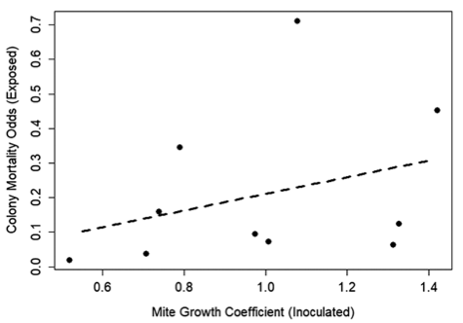
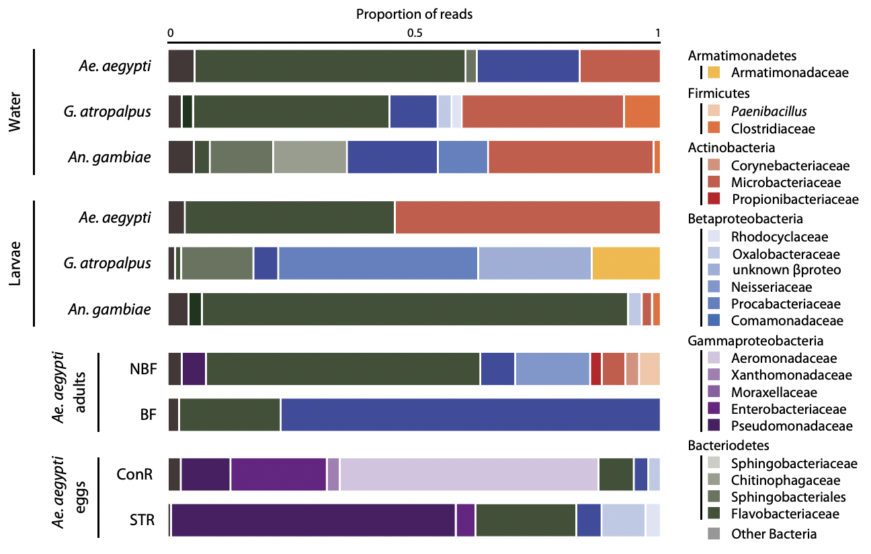
Examples
Dr. Bartlet’s Lab
Dr. Strand’s Lab

Slide 19
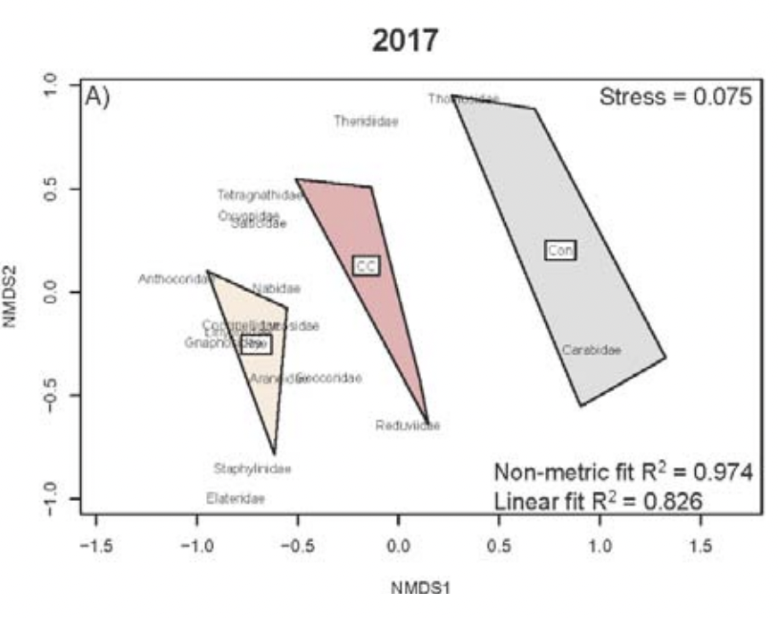
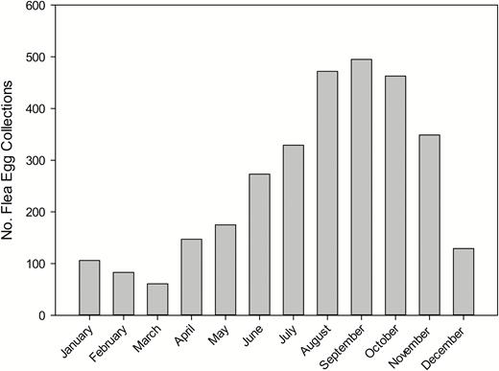
Examples
Dr. Schmidt’s Lab
Dr. Hinkle’s Lab

Slide 20
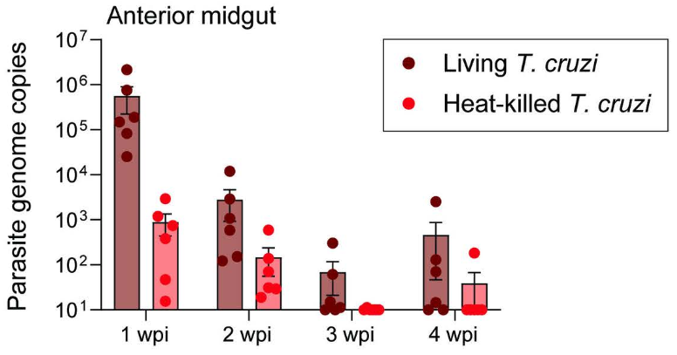
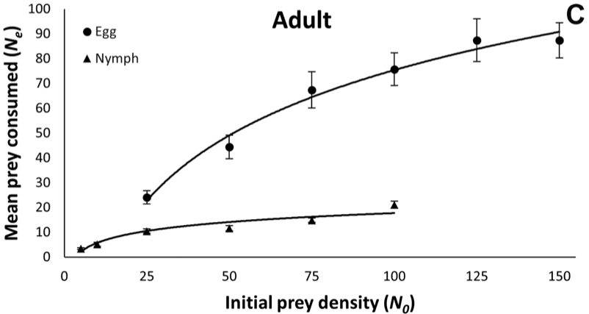
Examples
Dr. Schoeller’s Lab
Dr. Vogel’s Lab

Slide 21
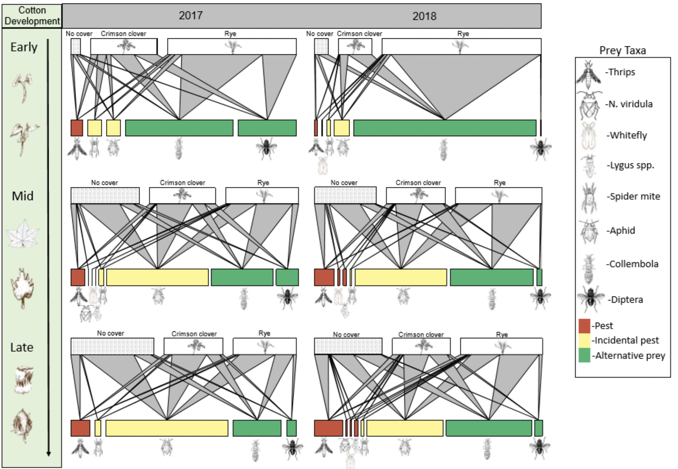
Complex Data Visualization

Slide 22
Downloading R/RStudio
Need to first download R software from CRAN website
Comprehensive R Archive Network
Then download RStudio software from Posit website
Open RStudio and follow along

Slide 23
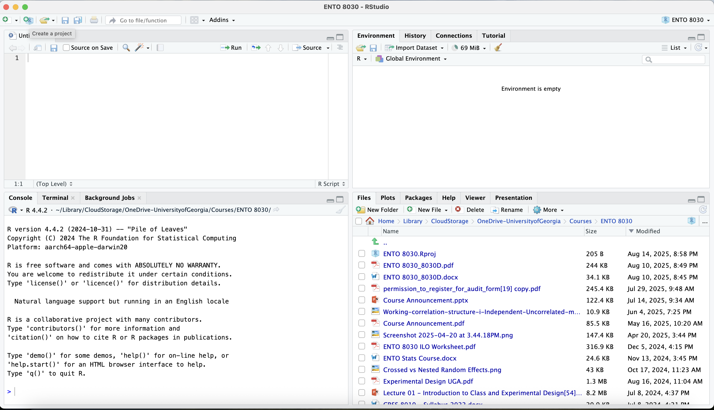
Basics of R/RStudio
Start by creating a project – new or existing directory

Slide 24
Basics of R/RStudio
Files tab – navigating folders and working directory
Relative path name – here() function

Slide 25
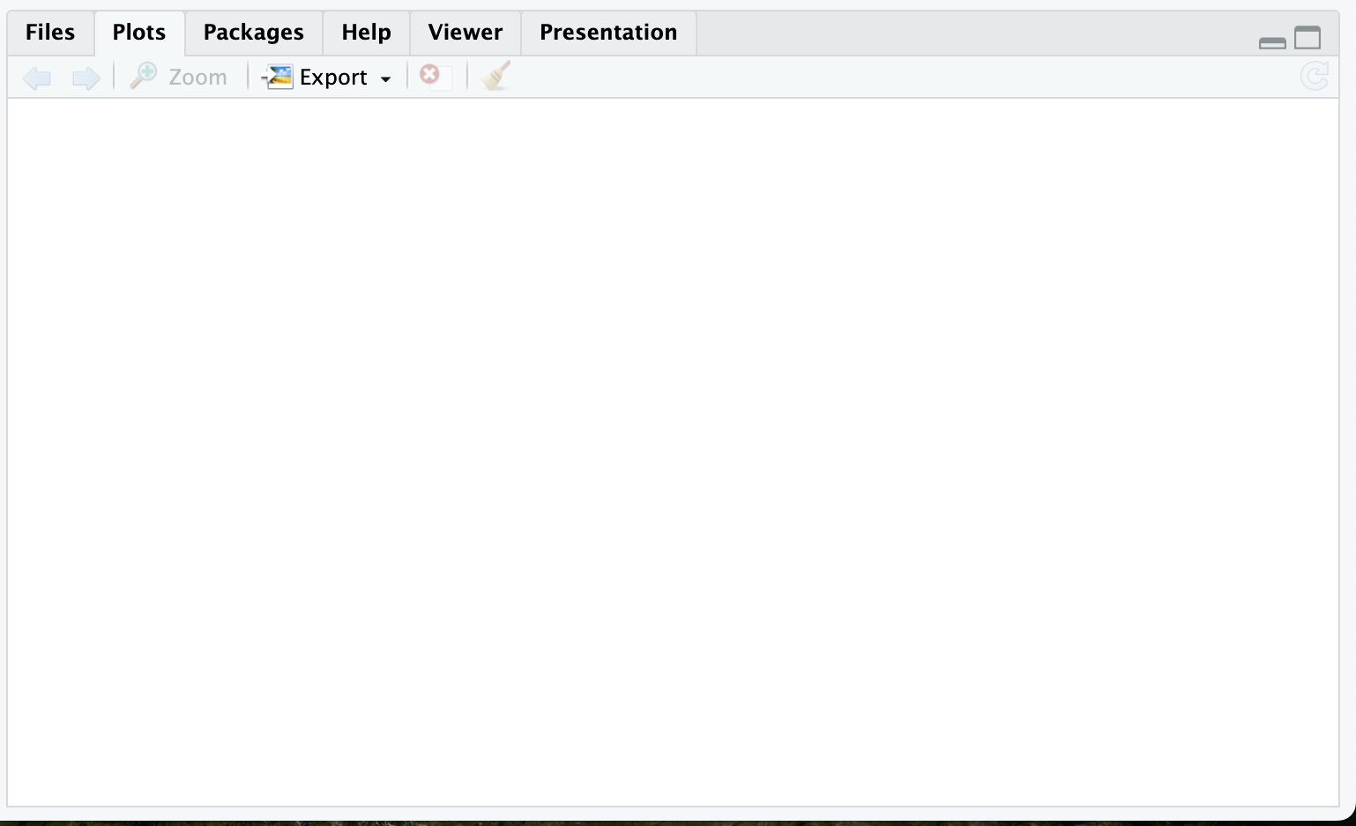
Basics of R/RStudio
Plots tab – display plots with limited function
Other functions to save images for publications/presentations

Slide 26
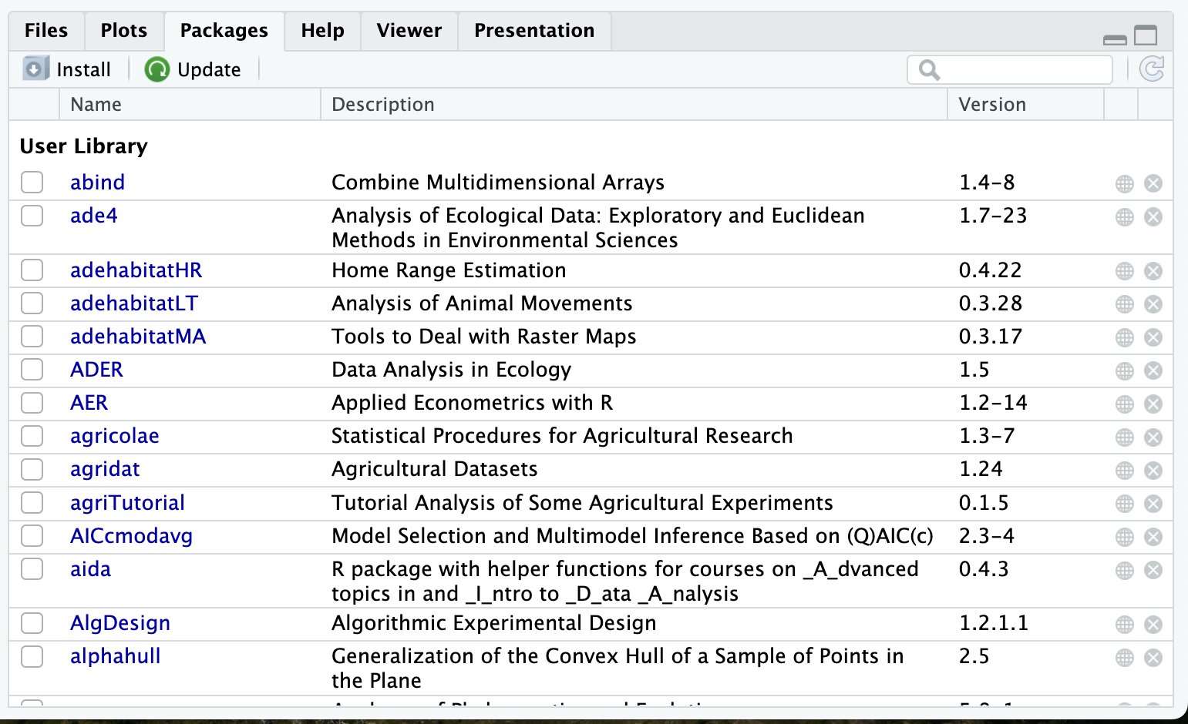
Basics of R/RStudio
Packages tab – list of packages already installed locally
Install vs. loading packages here or in script/console
Check version!

Slide 27
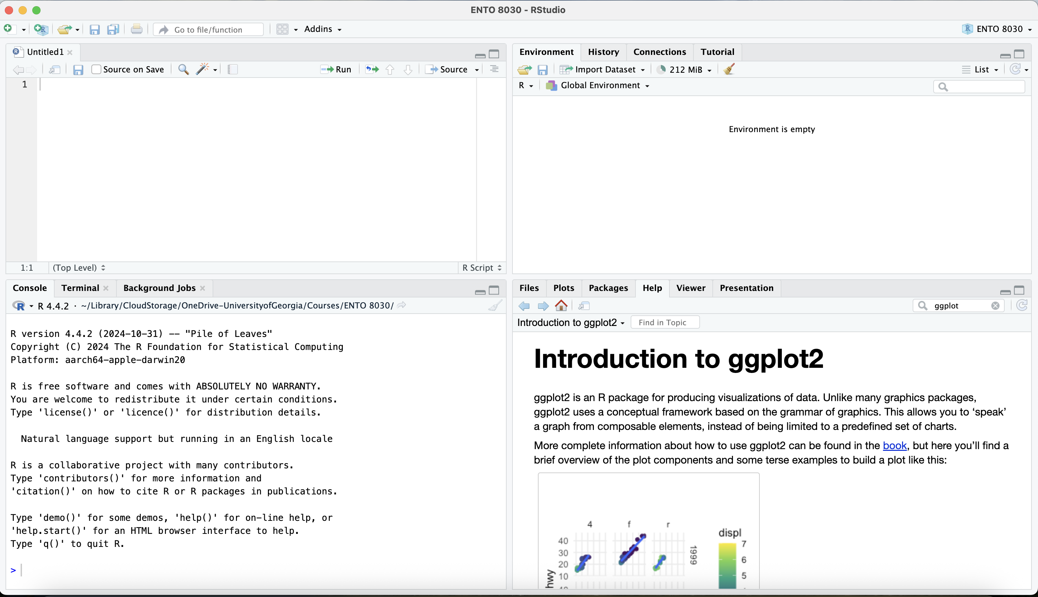
Basics of R/RStudio
Help tab – instructions on how to use packages/functions
Can type “?” before a package name or function in console

Slide 28
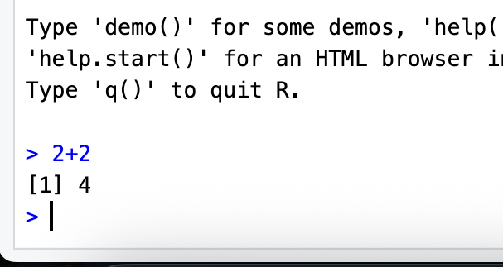
Basics of R/RStudio
Console tab – where you see output from code
Can run code directly in console – won’t save

Slide 29
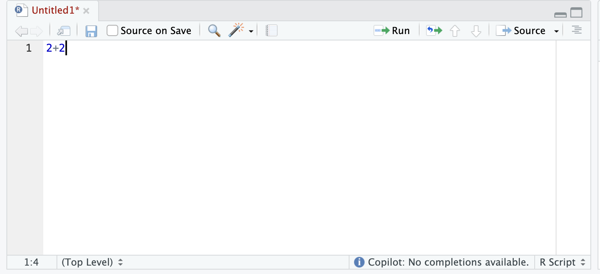
Basics of R/RStudio
Script tab – script and other document types are opened here
Code is typed here to be saved for future use - reproducible science

Slide 30
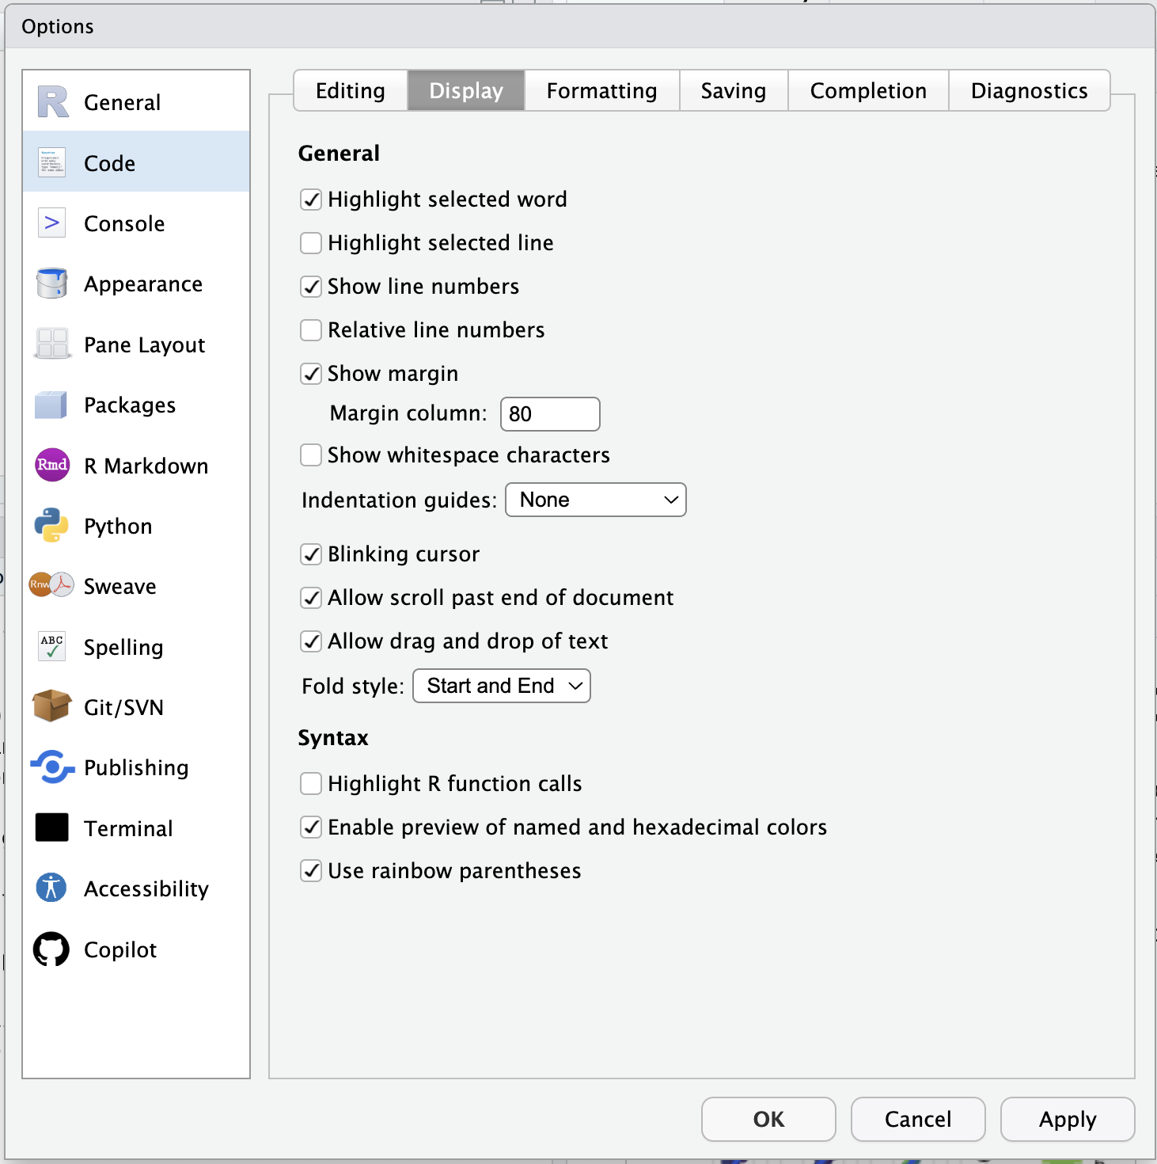
Basics of R/RStudio
Quality of life adjustments – Tools – Global Options
Change the following options – if you like

Slide 31
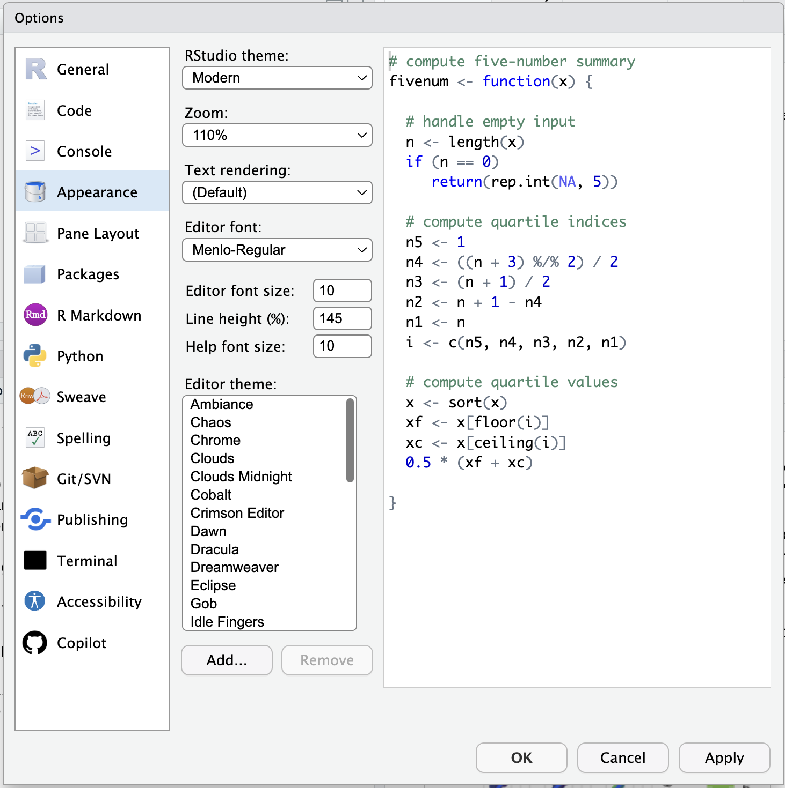
Basics of R/RStudio
Quality of life adjustments – Tools – Global Options
Change the following options – if you like

Slide 32
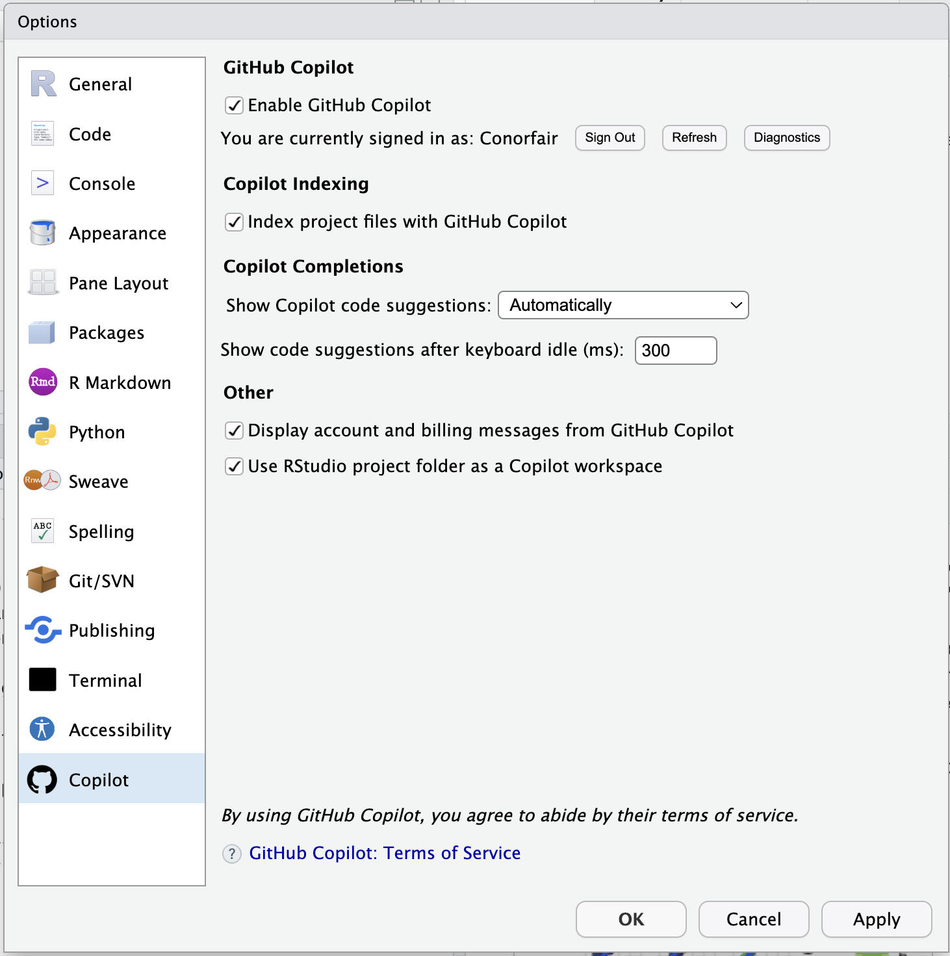
Basics of R/RStudio
Quality of life adjustments – Tools – Global Options
Change the following options – if you like

Slide 33
GitHub Accounts
GitHub account needed if you want to use Copilot code suggestions
Create account at github.com
Can apply for education benefits under billing and licensing

Slide 34
Review
Reviewed syllabus
Format of instruction lecture and discussion session
Course assignments and exams
“Ungrading” policy
Advanced topic selection – vote using link on eLC
Types of data and its impact on your hypotheses/analyses
Types of data visualizations based on your type of data
Basics of R/Rstudio and GitHub Accounts

